Slide 1
BREADCRUMBS/
Your Online Shopping Companion

Slide 2
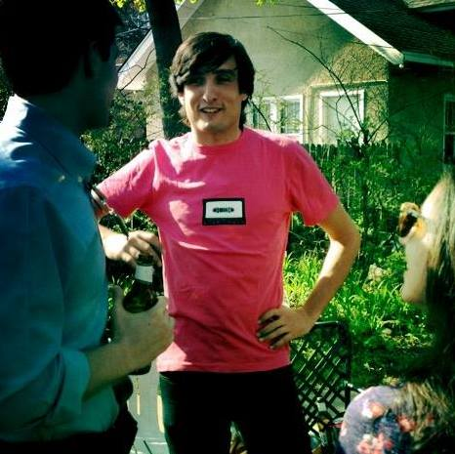

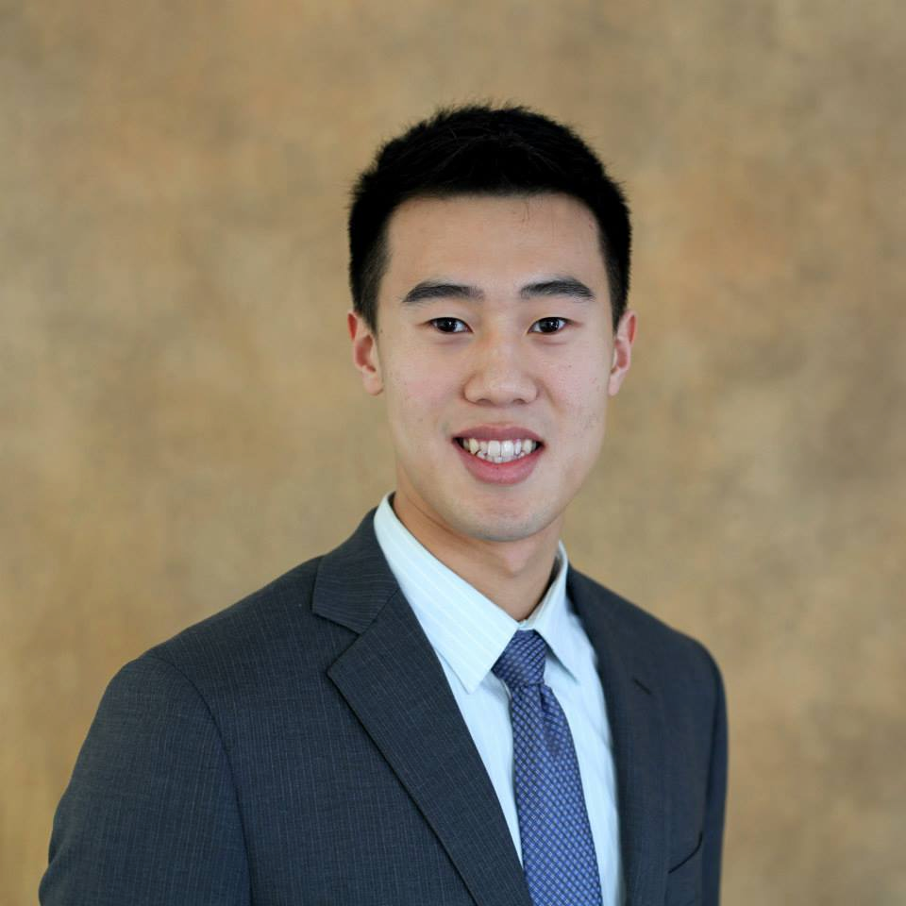

Project Manager
Ignacio Naveiras
Kellogg MBA ‘15
Design/Content
Penny Wang
Medill MSJ ‘15
Dev
Edward Hu
McCormick ‘16
Dev
Kevin Chen
McCormick ‘16

Slide 3
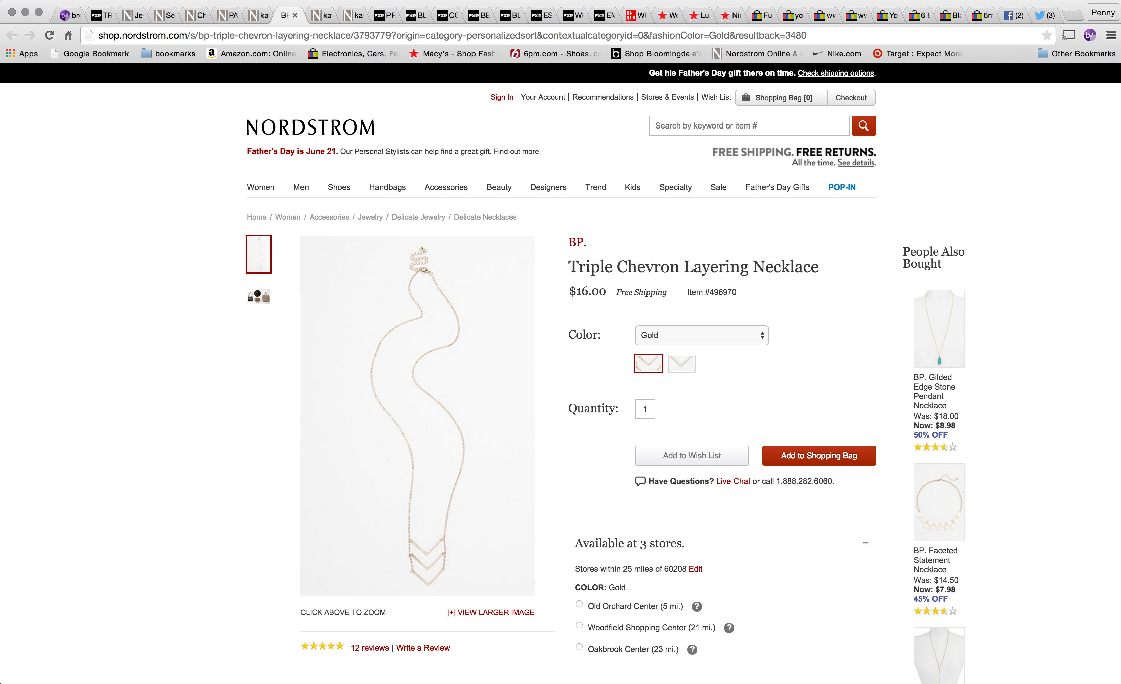

Slide 4
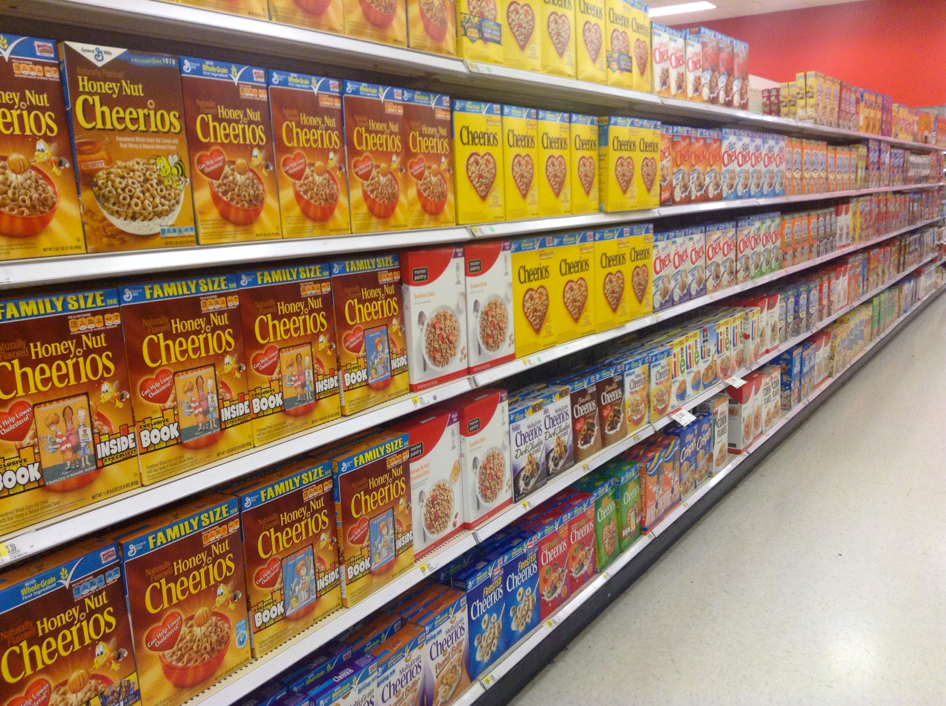
Online Shopping vs. Cereal Shopping

Slide 5

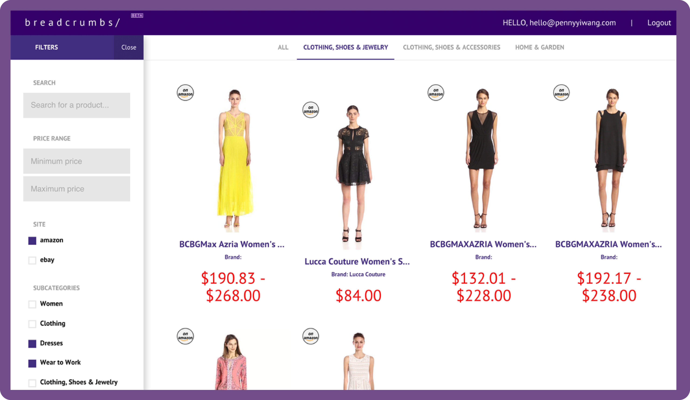
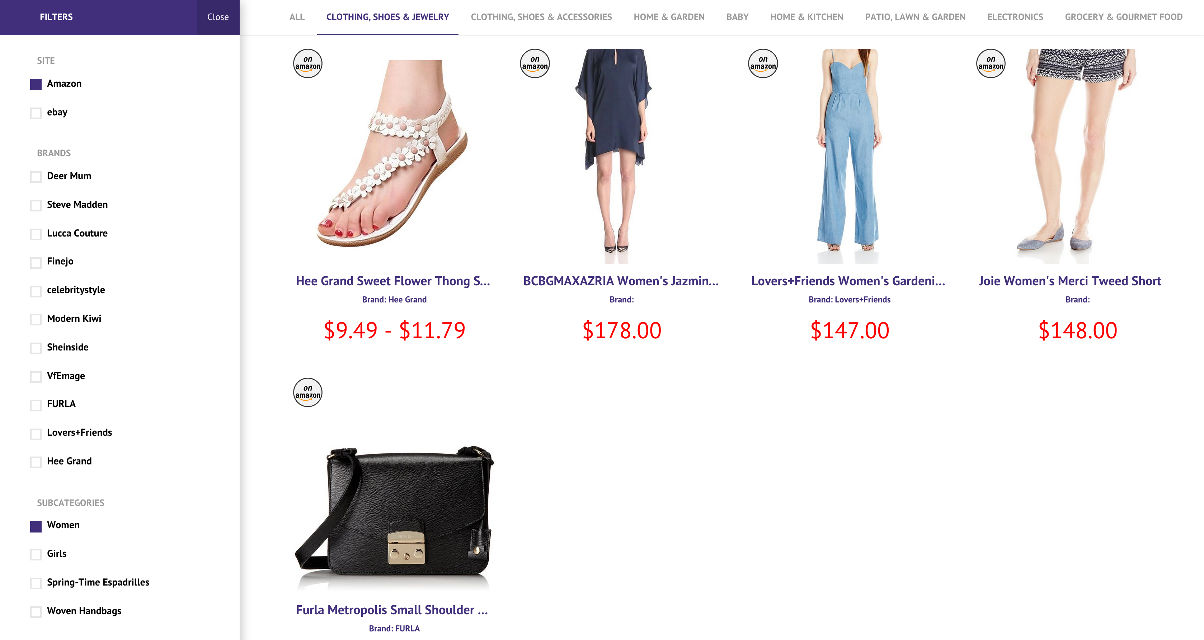
What is Breadcrumbs/
breadcrumbs is a chrome extension that helps you organize your online shopping research
sample dashboard

Slide 6
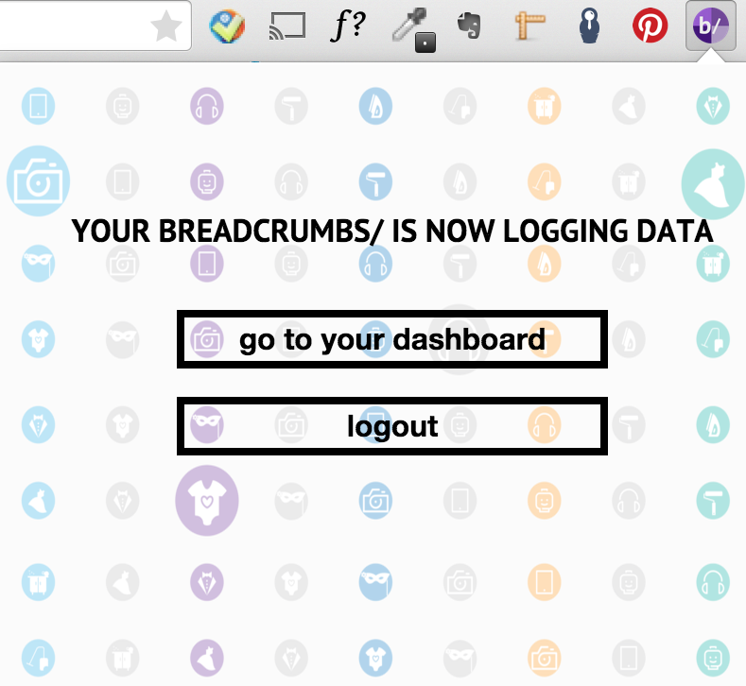
Features
breadcrumbs remembers
Once installed, the extension logs every product viewed without any effort from the user’s end.

Slide 7
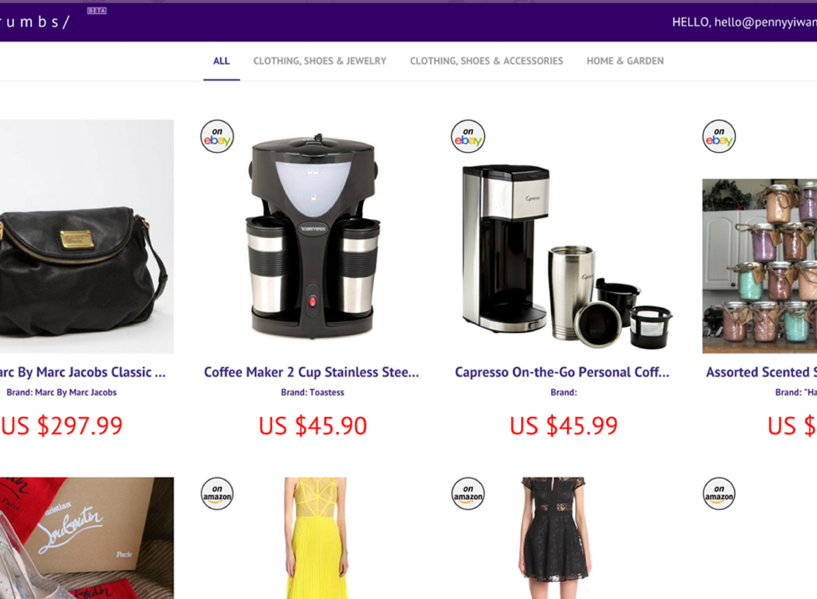
Features
sorted dashboard
The dashboard displays products by chronology and type of product.

Slide 8
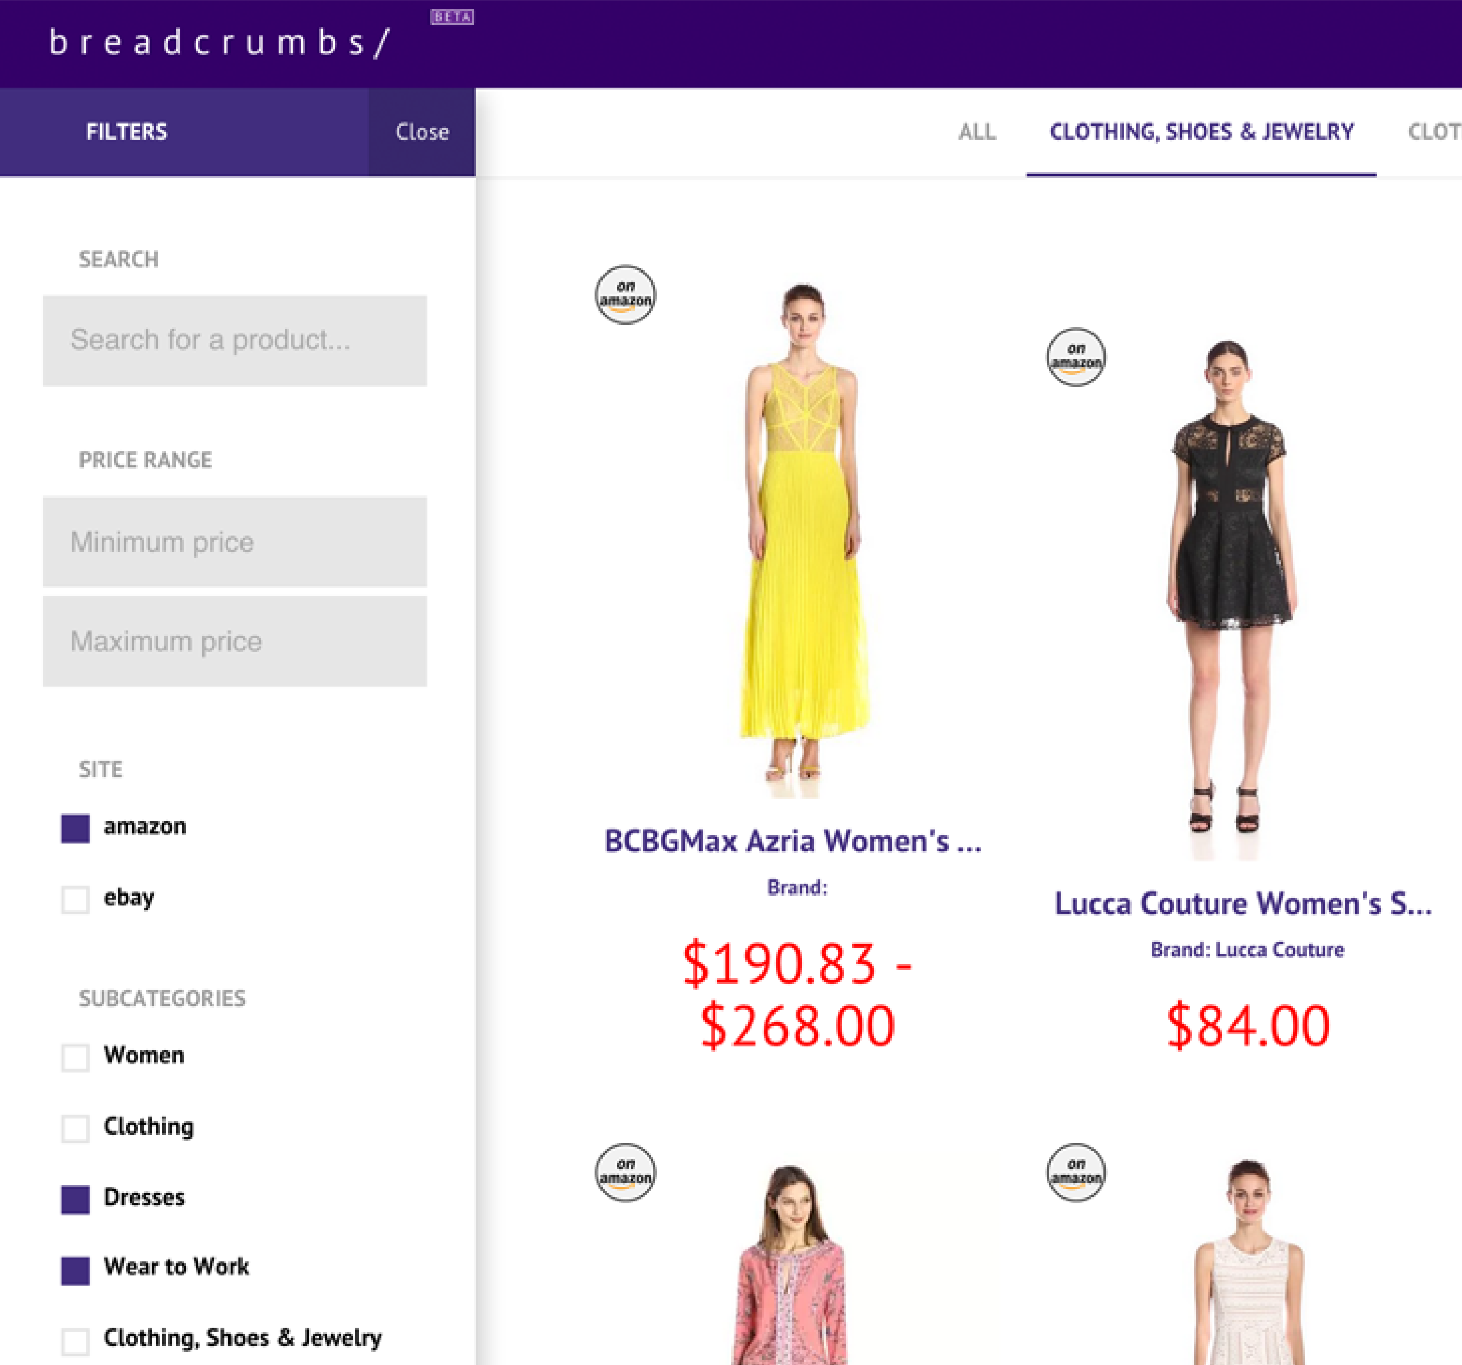
Features
filters & search
To locate the exact item, a user can simply narrow a category down using different filter and search functions.

Slide 9









Supported sites
…and more on the way

Slide 10



What are some alternatives?
wish lists
wish lists, recently viewed, shopping cart built into shopping sites
bookmarking tools
browser bookmark bar, Evernote web clipper, etc
price comparison tools
Pricewatch, Pricegrabber, etc

Slide 11
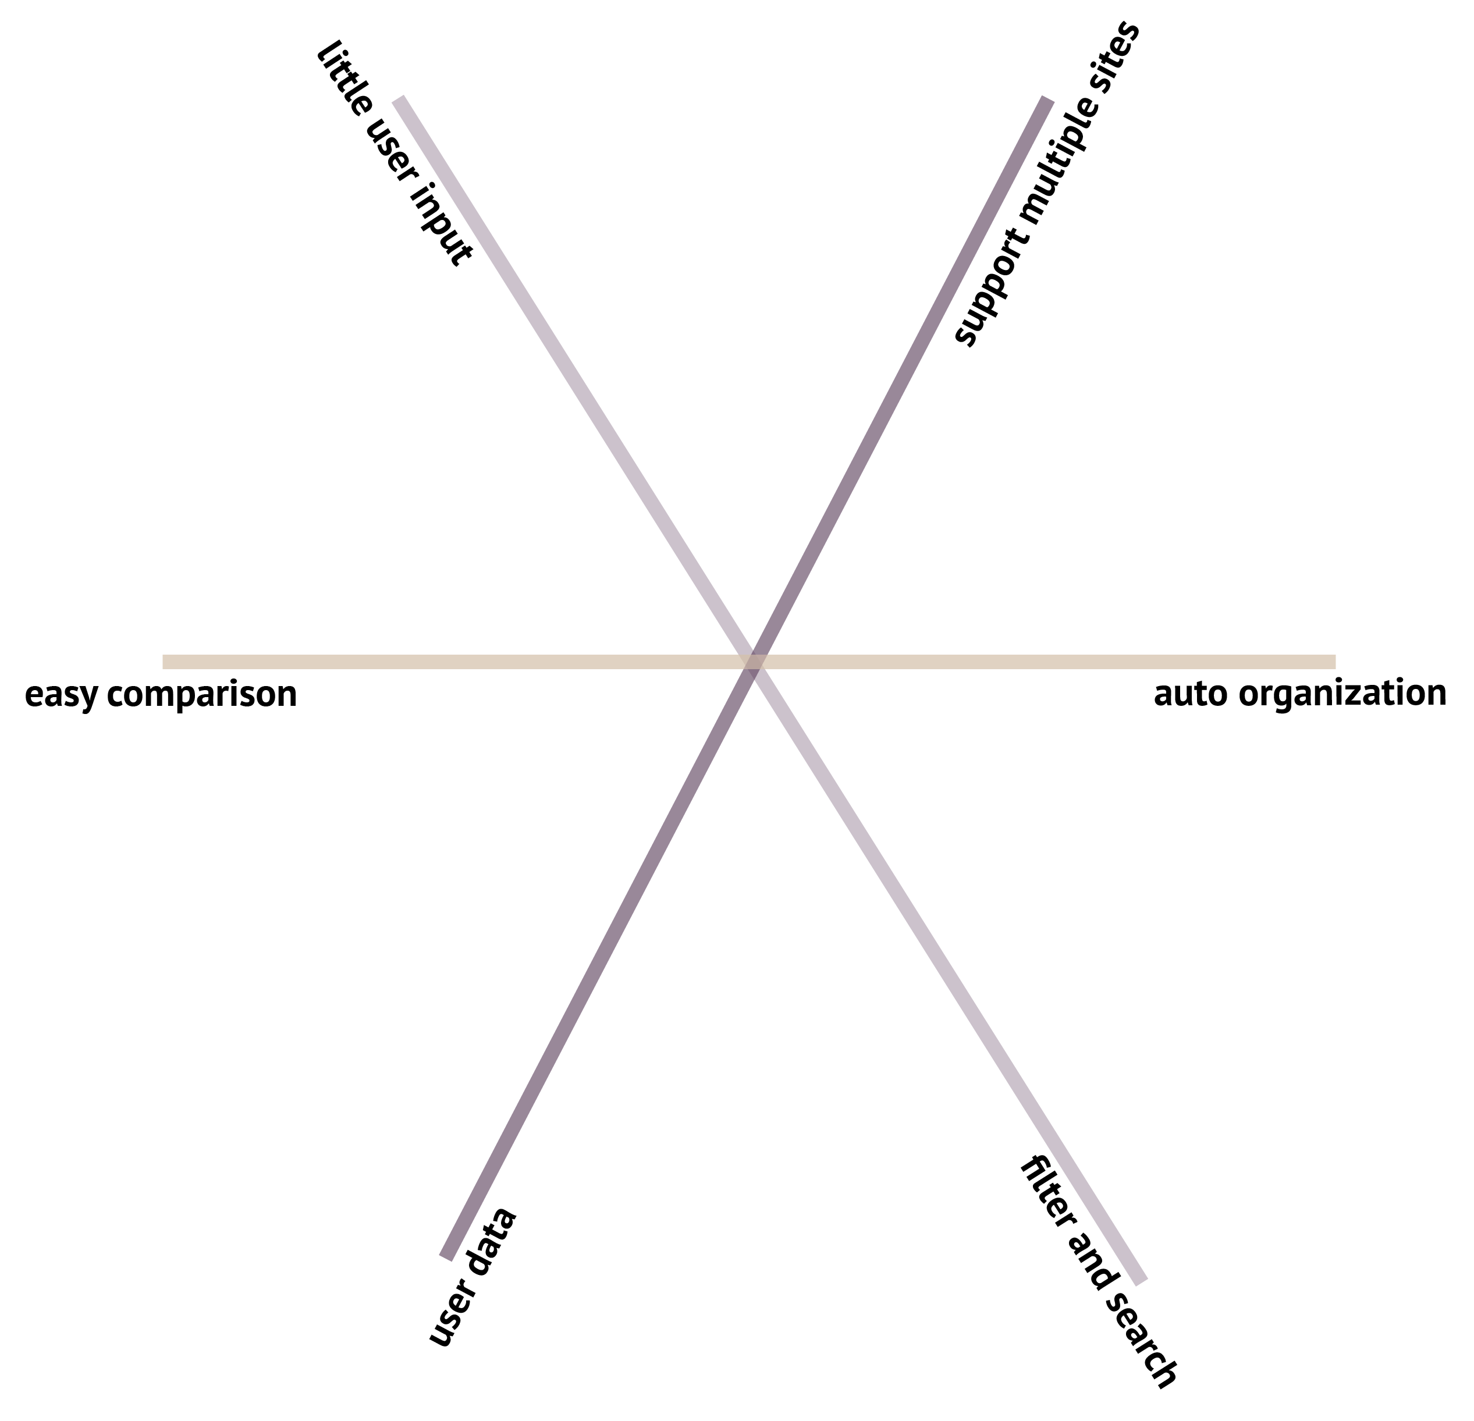
wish lists
wish lists, recently viewed, shopping cart

Slide 12
bookmarking tools
browser bookmark bar, evernote web clipper, etc

Slide 13
price comparison tools
pricewatch, pricegrabber, etc

Slide 14
Breadcrumbs/

Slide 15
Market Opportunities
90%
transactions still offline
We target online shoppers who buy from different sources.

Slide 16
Revenue Streams
Affiliate Programs
Online Shopping Data
Advertisement
^{est. revenue}
^{feasibility}
^{scalability}
^{5% of sales}
^{feasible}
^{scalable}
^{tbd}
^{feasibility}
^{scalability}
^{est. revenue}
^{feasibility}
^{scalability}

Slide 17
Timeline
March
April
May
June
Chrome Store launch;
Private launch event;
Social media launch
Chrome Store launch;
Private launch event;
Social media launch
Bug fixes (feedback);
Friends and family invites
Publicly listed on Chrome Store
Supporting more sites
Marketing

Slide 18


Next Steps
Add affiliate programs
$
Integrate more sites
Explore m-commerce opportunities

Slide 19
Thank you!
Questions?

Slide 20
Appendix 1: Customer Acquisition
Personal Network
Social Media
Online Publishing Platforms
ProductHunt/Bloggers
^{cost}
^{feasibility}
^{scalability}
^{progress}
^{$0}
^{very feasible}
^{not scalable}
^{27 active users}
^{CPC $3}
^{feasible}
^{2x to 10x}
^{5k impressions/mo}
^{$0}
^{feasible}
^{2 posts}
^{$0}
^{less feasible}
^{1 guest blog post}

Slide 21

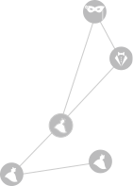
Target Segment
young professional women

